Slide 1
Cryptography and Network Security
Chapter 5
Fifth Edition
by William Stallings
Lecture slides by Lawrie Brown
Notes:
Lecture slides by Lawrie Brown for “Cryptography and Network Security”, 5/e, by William Stallings, Chapter Chapter 5 –”Advanced Encryption Standard”.

Slide 2
Chapter 5 –Advanced Encryption Standard
"It seems very simple."
"It is very simple. But if you don't know what the key is it's virtually indecipherable."
—Talking to Strange Men, Ruth Rendell
Notes:
Intro quote.

Slide 3
AES Origins
clear a replacement for DES was needed
  have theoretical attacks that can break it
  have demonstrated exhaustive key search attacks
can use Triple-DES – but slow, has small blocks
US NIST issued call for ciphers in 1997
15 candidates accepted in Jun 98
5 were shortlisted in Aug-99
Rijndael was selected as the AES in Oct-2000
issued as FIPS PUB 197 standard in Nov-2001
Notes:
The Advanced Encryption Standard (AES) was published by NIST (National Institute of Standards and Technology) in 2001. AES is a symmetric block cipher that is intended to replace DES as the approved standard for a wide range of applications. The AES cipher (& other candidates) form the latest generation of block ciphers, and now we see a significant increase in the block size - from the old standard of 64-bits up to 128-bits; and keys from 128 to 256-bits. In part this has been driven by the public demonstrations of exhaustive key searches of DES. Whilst triple-DES is regarded as secure and well understood, it is slow, especially in s/w. In a first round of evaluation, 15 proposed algorithms were accepted. A second round narrowed the field to 5 algorithms. NIST completed its evaluation process and published a final standard (FIPS PUB 197) in November of 2001. NIST selected Rijndael as the proposed AES algorithm. The two researchers who developed and submitted Rijndael for the AES are both cryptographers from Belgium: Dr. Joan Daemen and Dr.Vincent Rijmen.

Slide 4
Finite Field Arithmetic
In the Advanced Encryption Standard (AES) all operations are performed on 8-bit bytes
The arithmetic operations of addition, multiplication, and division are performed over the finite field GF(2⁸)
A field is a set in which we can do addition, subtraction, multiplication, and division without leaving the set
Division is defined with the following rule:
  a /b = a (b⁻¹ )
  An example of a finite field (one with a finite number of elements) is the set Z_{p} consisting of all the integers {0, 1, . . . . , p - 1}, where p is a prime number and in which arithmetic is carried out modulo p

Slide 5
The AES Cipher - Rijndael
designed by Rijmen-Daemen in Belgium
has 128/192/256 bit keys, 128 bit data
an iterative rather than Feistel cipher
  processes data as block of 4 columns of 4 bytes
  operates on entire data block in every round
designed to have:
  resistance against known attacks
  speed and code compactness on many CPUs
  design simplicity
Notes:
The Rijndael proposal for AES defined a cipher in which the block length and the key length can be independently specified to be 128,192,or 256 bits. The AES specification uses the same three key size alternatives but limits the block length to 128 bits. Rijndael is an academic submission, based on the earlier Square cipher, from Belgium academics Dr Joan Daemen and Dr Vincent Rijmen. It is an iterative cipher (operates on entire data block in every round) rather than feistel (operate on halves at a time), and was designed to have characteristics of: Resistance against all known attacks, Speed and code compactness on a wide range of platforms, & Design simplicity.

Slide 6
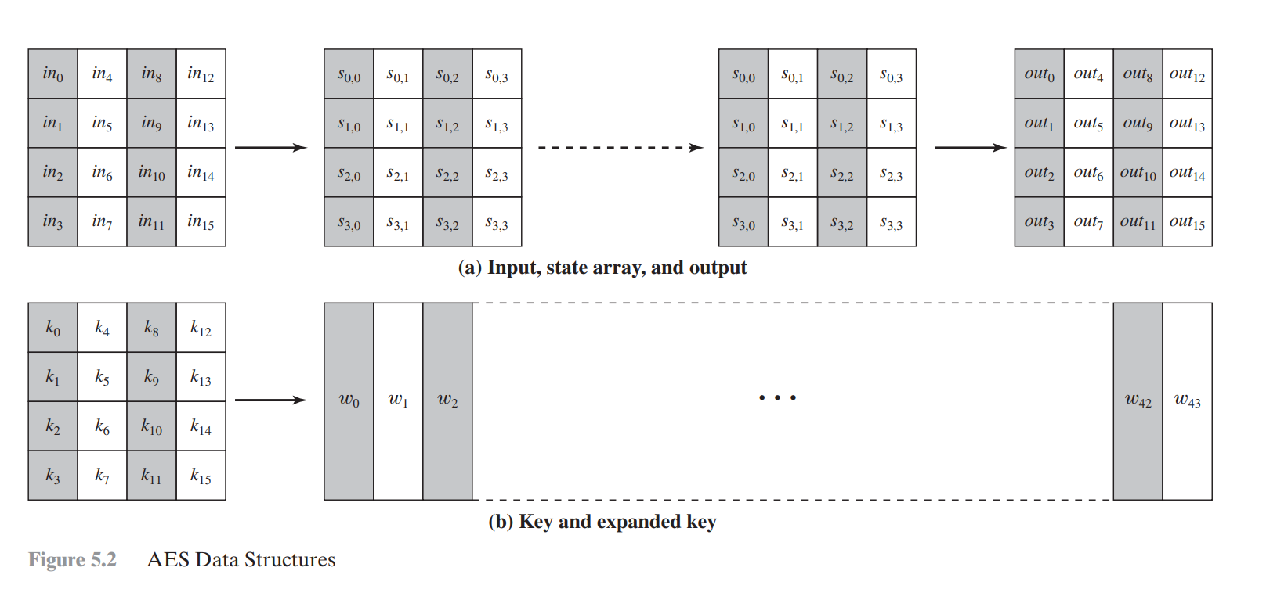

Slide 7
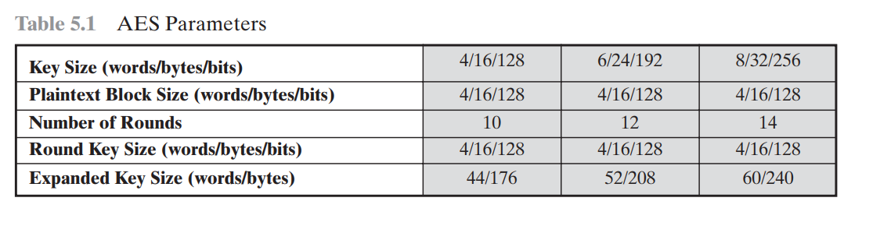

Slide 8
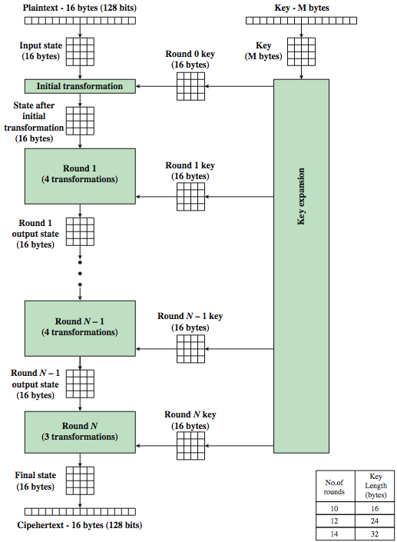
AES Encryption Process
Notes:
Stallings Figure 5.1 shows the overall encryption process in AES.

Slide 9

AES Structure
Notes:
Stallings Figure 5.3 shows the structure of AES in more detail. The cipher consists of N rounds, where the number of rounds depends on the key length: 10 rounds for a 16-byte key; 12 rounds for a 24-byte key; and 14 rounds for a 32-byte key. The first N – 1 rounds consist of four distinct transformation functions: SubBytes, ShiftRows, MixColumns, and AddRoundKey, which are described subsequently. The final round contains only 3 transformation, and there is a initial single transformation (AddRoundKey) before the first round, which can be considered Round 0. Each transformation takes one or more 4 x 4 matrices as input and produces a 4 x 4 matrix as output. Figure 5.1 shows that the output of each round is a 4 x 4 matrix, with the output of the final round being the ciphertext. Also, the key expansion function generates N + 1 round keys, each of which is a distinct 4 x 4 matrix. Each round key serve as one of the inputs to the AddRoundKey transformation in each round.

Slide 10
Some Comments on AES
Processes the entire data block as a single matrix during each round using substitutions and permutation
The key that is provided as input is expanded into an array of forty-four 32-bit words, w[i]
Substitute bytes – uses an S-box to perform a byte-by-byte substitution of the block
ShiftRows – a simple permutation
MixColumns – a substitution that makes use of arithmetic over GF(2⁸)
AddRoundKey – a simple bitwise XOR of the current block with a portion of the expanded key
The cipher begins and ends with an AddRoundKey stage
Can view the cipher as alternating operations of XOR encryption (AddRoundKey) of a block, followed by scrambling of the block (the other three stages), followed by XOR encryption, and so on
Each stage is easily reversible
The decryption algorithm makes use of the expanded key in reverse order, however the decryption algorithm is not identical to the encryption algorithm
State is the same for both encryption and decryption
Final round of both encryption and decryption consists of only three stages
Notes:
Before delving into details, can make several comments about the overall AES structure. See text for details.

Slide 11
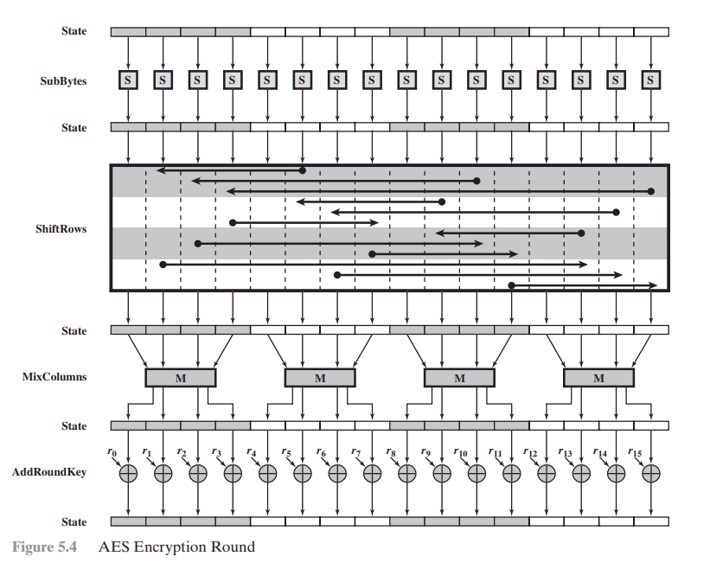

Slide 12
Substitute Bytes
a simple substitution of each byte
uses one table of 16x16 bytes containing a permutation of all 256 8-bit values
each byte of state is replaced by byte indexed by row (left 4-bits) & column (right 4-bits)
  eg. byte {95} is replaced by byte in row 9 column 5
  which has value {2A}
S-box constructed using defined transformation of values in GF(2⁸)
designed to be resistant to all known attacks
Notes:
We now turn to a discussion of each of the four transformations used in AES. For each stage, we mention the forward (encryption) algorithm, the inverse (decryption) algorithm, and the rationale for the design of that stage.
The Substitute bytes stage uses an S-box to perform a byte-by-byte substitution of the block. There is a single 8-bit wide S-box used on every byte. This S-box is a permutation of all 256 8-bit values, constructed using a transformation which treats the values as polynomials in GF(2⁸) – however it is fixed, so really only need to know the table when implementing. Decryption requires the inverse of the table. These tables are given in Stallings Table 5.2.
The table was designed to be resistant to known cryptanalytic attacks. Specifically, the Rijndael developers sought a design that has a low correlation between input bits and output bits, with the property that the output cannot be described as a simple mathematical function of the input, with no fixed points and no “opposite fixed points”.

Slide 13
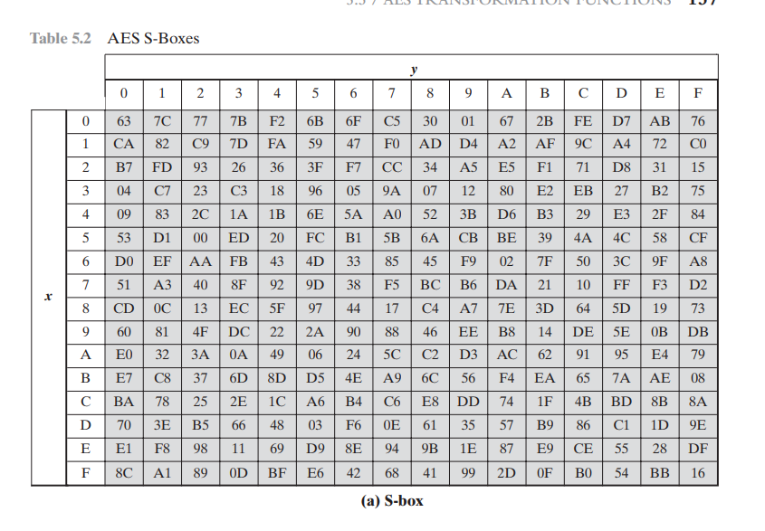

Slide 14
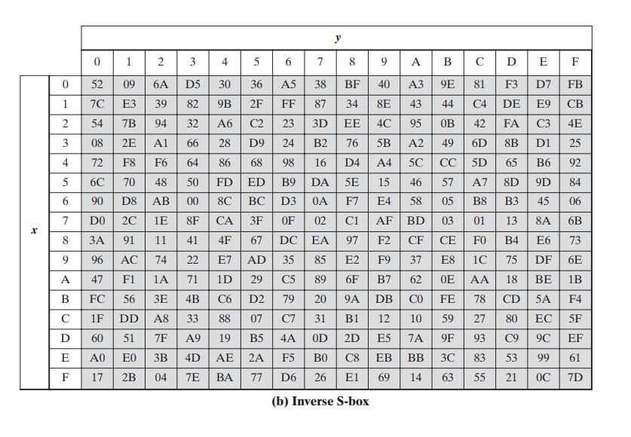

Slide 15

Substitute Bytes
Notes:
As this diagram from Stallings Fig 5.5a shows, the Byte Substitution operates on each byte of state independently, with the input byte used to index a row/col in the table to retrieve the substituted value.

Slide 16

Substitute Bytes Example
Notes:
Show an example of the SubBytes transformation from the text.

Slide 17
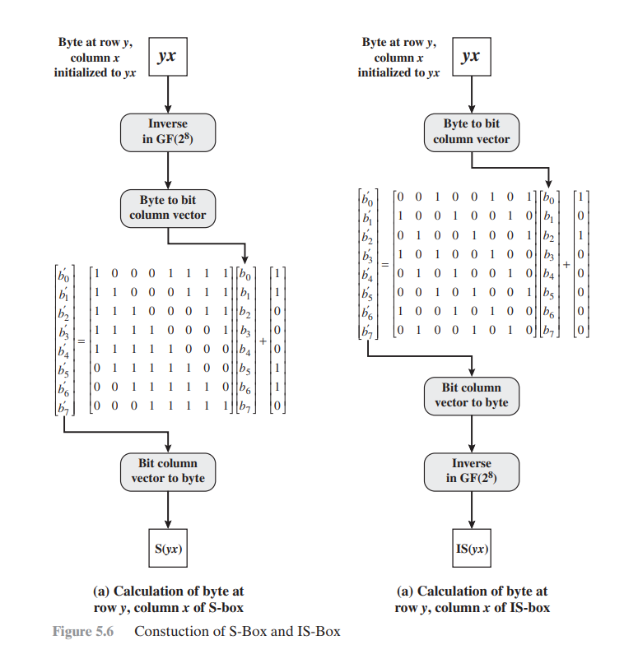

Slide 18
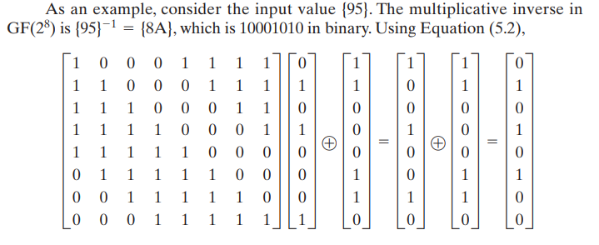

Slide 19
Shift Rows
a circular byte shift in each each
  1st row is unchanged
  2nd row does 1 byte circular shift to left
  3rd row does 2 byte circular shift to left
  4th row does 3 byte circular shift to left
decrypt inverts using shifts to right
since state is processed by columns, this step permutes bytes between the columns
Notes:
The ShiftRows stage provides a simple “permutation” of the data, whereas the other steps involve substitutions. Further, since the state is treated as a block of columns, it is this step which provides for diffusion of values between columns. It performs a circular rotate on each row of 0, 1, 2 & 3 places for respective rows. When decrypting it performs the circular shifts in the opposite direction for each row. This row shift moves an individual byte from one column to another, which is a linear distance of a multiple of 4 bytes, and ensures that the 4 bytes of one column are spread out to four different columns.

Slide 20


Shift Rows
Notes:
Stalling Figure 5.7a illustrates the Shift Rows permutation. Then show an example of ShiftRows from the text.

Slide 21

Mix Columns
each column is processed separately
each byte is replaced by a value dependent on all 4 bytes in the column
effectively a matrix multiplication in GF(2⁸) using prime poly m(x) =x⁸+x⁴+x³+x+1
Notes:
The forward mix column transformation, called MixColumns, operates on each column individually. Each byte of a column is mapped into a new value that is a function of all four bytes in that column. It is a substitution that makes use of arithmetic over GF(2^8). Each byte of a column is mapped into a new value that is a function of all four bytes in that column. It is designed as a matrix multiplication where each byte is treated as a polynomial in GF(2⁸). The inverse used for decryption involves a different set of constants.
The constants used are based on a linear code with maximal distance between code words – this gives good mixing of the bytes within each column. Combined with the “shift rows” step provides good avalanche, so that within a few rounds, all output bits depend on all input bits.

Slide 22

Mix Columns
Notes:
Stalling Figure 5.5b illustrates the Mix Columns transformation.

Slide 23

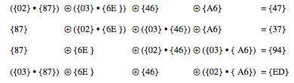
Mix Columns Example
Notes:
Show an example of the MixColumns transformation from the text, along with verification of the first column of this example.

Slide 24
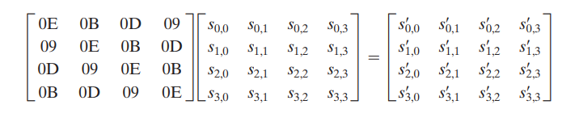
Inverse Mix Column

Slide 25
AES Arithmetic
uses arithmetic in the finite field GF(2⁸)
with irreducible polynomial
  m(x) = x⁸ + x⁴ + x³ + x + 1
  which is (100011011) or {11b}
e.g.
  {02} • {87} mod {11b} = (1 0000 1110) mod {11b}
  = (1 0000 1110) xor (1 0001 1011) = (0001 0101)
Notes:
AES uses arithmetic in the finite field GF(2⁸), with the irreducible polynomial m(x) = x⁸ + x⁴ + x³ + x + 1. AES operates on 8-bit bytes. Addition of two bytes is defined as the bitwise XOR operation. Multiplication of two bytes is defined as multiplication in the finite field GF(2⁸). In particular, multiplication of a value by x (i.e., by {02}) can be implemented as a 1-bit left shift followed by a conditional bitwise XOR with (0001 1011) if the leftmost bit of the original value (prior to the shift) is 1.

Slide 26
Mix Columns
can express each col as 4 equations
  to derive each new byte in col
decryption requires use of inverse matrix
  with larger coefficients, hence a little harder
have an alternate characterisation
  each column a 4-term polynomial
  with coefficients in GF(2⁸)
  and polynomials multiplied modulo (x⁴+1)
coefficients based on linear code with maximal distance between codewords
Notes:
In practise, you implement Mix Columns by expressing the transformation on each column as 4 equations (Stallings equation 5.4) to compute the new bytes for that column. This computation only involves shifts, XORs & conditional XORs (for the modulo reduction).
The decryption computation requires the use of the inverse of the matrix, which has larger coefficients, and is thus potentially a little harder & slower to implement.
The designers & the AES standard provide an alternate characterisation of Mix Columns, which treats each column of State to be a four-term polynomial with coefficients in GF(2⁸). Each column is multiplied by a fixed polynomial a(x) given in Stallings eqn 5.7. Whilst this is useful for analysis of the stage, the matrix description is all that’s required for implementation.
The coefficients of the matrix are based on a linear code with maximal distance between code words, which ensures a good mixing among the bytes of each column. The mix column transformation combined with the shift row transformation ensures that after a few rounds, all output bits depend on all input bits. In addition, the choice of coefficients in MixColumns, which are all {01}, {02}, or {03}, was influenced by implementation considerations.

Slide 27
Add Round Key
XOR state with 128-bits of the round key
again processed by column (though effectively a series of byte operations)
inverse for decryption identical
  since XOR own inverse, with reversed keys
designed to be as simple as possible
  a form of Vernam cipher on expanded key
  requires other stages for complexity / security
Notes:
Lastly is the Add Round Key stage which is a simple bitwise XOR of the current block with a portion of the expanded key. Note this is the only step which makes use of the key and obscures the result, hence MUST be used at start and end of each round, since otherwise could undo effect of other steps. But the other steps provide confusion/diffusion/non-linearity. That us you can look at the cipher as a series of XOR with key then scramble/permute block repeated. This is efficient and highly secure it is believed.

Slide 28

Add Round Key
Notes:
Stallings Figure 5.5b illustrates the Add Round Key stage, which like Byte Substitution, operates on each byte of state independently.

Slide 29
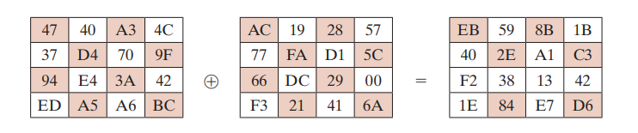

Slide 30

AES Round
Notes:
Can thus now view all the internal details of the AES round, showing how each byte of the state is manipulated, as shown in Stallings Figure 5.4.

Slide 31
AES Key Expansion
takes 128-bit (16-byte) key and expands into array of 44/52/60 32-bit words
start by copying key into first 4 words
then loop creating words that depend on values in previous & 4 places back
  in 3 of 4 cases just XOR these together
  1st word in 4 has rotate + S-box + XOR round constant on previous, before XOR 4th back
Notes:
The AES key expansion algorithm takes as input a 4-word (16-byte) key and produces a linear array of words, providing a 4-word round key for the initial AddRoundKey stage and each of the 10/12/14 rounds of the cipher. It involves copying the key into the first group of 4 words, and then constructing subsequent groups of 4 based on the values of the previous & 4th back words. The first word in each group of 4 gets “special treatment” with rotate + S-box + XOR constant on the previous word before XOR’ing the one from 4 back. In the 256-bit key/14 round version, there’s also an extra step on the middle word. The text includes in section 5.4 pseudocode that describes the key expansion.

Slide 32
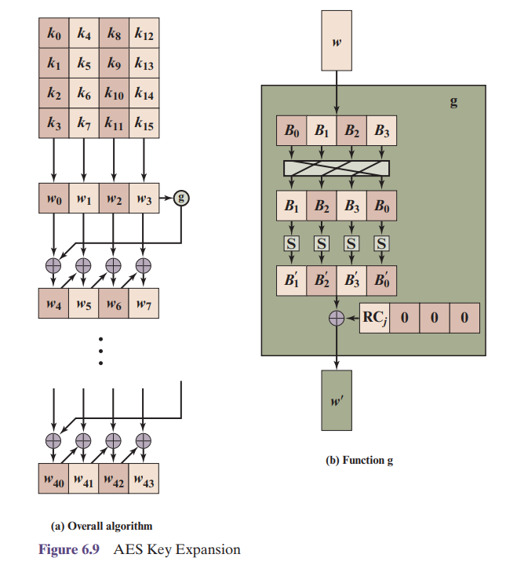

AES Key Expansion
Notes:
The first block of the AES Key Expansion is shown here in Stallings Figure 5.9a. It shows each group of 4 bytes in the key being assigned to the first 4 words, then the calculation of the next 4 words based on the values of the previous 4 words, which is repeated enough times to create all the necessary subkey information.

Slide 33
Key Expansion Rationale
designed to resist known attacks
design criteria included
  knowing part key insufficient to find many more
  invertible transformation
  fast on wide range of CPU’s
  use round constants to break symmetry
  diffuse key bits into round keys
  enough non-linearity to hinder analysis
  simplicity of description
Notes:
The Rijndael developers designed the expansion key algorithm to be resistant to known cryptanalytic attacks. It is designed to be simple to implement, but by using round constants break symmetries, and make it much harder to deduce other key bits if just some are known (but once have as many consecutive bits as are in key, can then easily recreate the full expansion). The design criteria used are listed above.

Slide 34
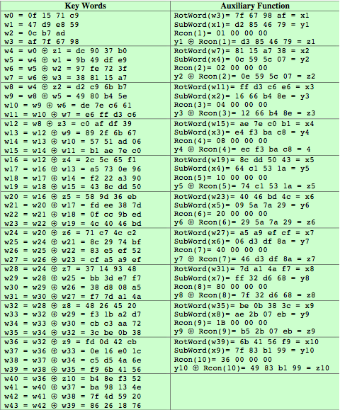
AES Example Key Expansion
Notes:
We now work through an example, and consider some of its implications. The plaintext, key, and resulting ciphertext are as follows:
Plaintext: 0123456789abcdeffedcba9876543210
Key: 0f1571c947d9e8590cb7add6af7f6798
Ciphertext: ff0b844a0853bf7c6934ab4364148fb9
Table 5.3 shows the expansion of the 16-byte key into 10 round keys. As previously explained, this process is performed word by word, with each four-byte word occupying one column of the word round key matrix. The left hand column shows the four round key words generated for each round. The right hand column shows the steps used to generate the auxiliary word used in key expansion. We begin, of course, with the key itself serving as the round key for round 0.

Slide 35
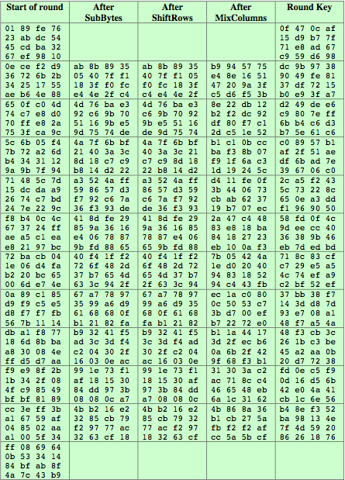
AES Example Encryption
Notes:
Next, Table 5.4 shows the progression of the state matrix through the AES encryption process. The first column shows the value of the state matrix at the start of a round. For the first row, the state matrix is just the matrix arrangement of the plaintext. The second, third, and fourth columns show the value of the state matrix for that round after the SubBytes, ShiftRows, and MixColumns transformations, respectively. The fifth column shows the round key. You can verify that these round keys equate with those shown in Table 5.3. The first column shows the value of the state matrix resulting from the bitwise XOR of the state after the preceding MixColumns with the round key for the preceding round.

Slide 36
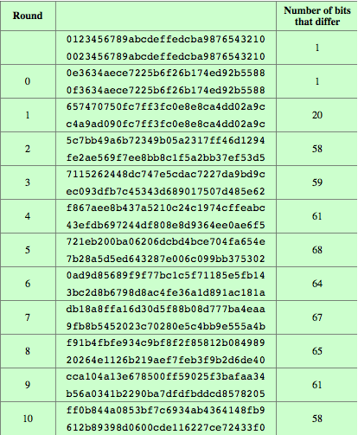
AES Example Avalanche
Notes:
In any good cipher design, want the avalanche effect, in which a small change in plaintext or key produces a large change in the ciphertext. Using the example from Table 5.4, Table 5.5 shows the result when the eighth bit of the plaintext is changed. The second column of the table shows the value of the state matrix at the end of each round for the two plaintexts. Note that after just one round, 20 bits of the state vector differ. And after two rounds, close to half the bits differ. This magnitude of difference propagates through the remaining rounds. A bit difference in approximately half the positions in the most desirable outcome.

Slide 37
AES Decryption
AES decryption is not identical to encryption since steps done in reverse
but can define an equivalent inverse cipher with steps as for encryption
  but using inverses of each step
  with a different key schedule
works since result is unchanged when
  swap byte substitution & shift rows
  swap mix columns & add (tweaked) round key
Notes:
The AES decryption cipher is not identical to the encryption cipher (Stallings Figure 5.3). The sequence of transformations for decryption differs from that for encryption, although the form of the key schedules for encryption and decryption is the same. This has the disadvantage that two separate software or firmware modules are needed for applications that require both encryption and decryption. There is, however, an equivalent version of the decryption algorithm that has the same structure as the encryption algorithm, with the same sequence of transformations as the encryption algorithm (with transformations replaced by their inverses). To achieve this equivalence, a change in key schedule is needed.
By constructing an equivalent inverse cipher with steps in same order as for encryption, we can derive a more efficient implementation. Clearly swapping the byte substitutions and shift rows has no effect, since work just on bytes. Swapping the mix columns and add round key steps requires the inverse mix columns step be applied to the round keys first – this makes the decryption key schedule a little more complex with this construction, but allows the use of same h/w or s/w for the data en/decrypt computation.

Slide 38
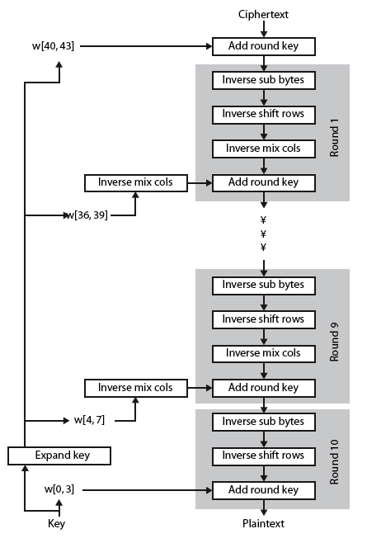
AES Decryption
Notes:
Illustrate the equivalent inverse cipher with Stallings Figure 5.10.

Slide 39
Implementation Aspects
can efficiently implement on 8-bit CPU
  byte substitution works on bytes using a table of 256 entries
  shift rows is simple byte shift
  add round key works on byte XOR’s
  mix columns requires matrix multiply in GF(2⁸) which works on byte values, can be simplified to use table lookups & byte XOR’s
Notes:
The Rijndael proposal [DAEM99] provides some suggestions for efficient implementation on 8- bit processors, typical for current smart cards, and on 32-bit processors, typical for PCs.
AES can be implemented very efficiently on an 8-bit processor.
AddRoundKey is a bytewise XOR operation.
ShiftRows is a simple byte shifting operation.
SubBytes operates at the byte level and only requires a lookup of a 256 byte table S.
MixColumns (matrix multiply) can be implemented as byte XOR’s & table lookups with a 2nd 256 byte table X2, using the formulae shown in Stallings equation 5.9.

Slide 40
Implementation Aspects
can efficiently implement on 32-bit CPU
  redefine steps to use 32-bit words
  can precompute 4 tables of 256-words
  then each column in each round can be computed using 4 table lookups + 4 XORs
  at a cost of 4Kb to store tables
designers believe this very efficient implementation was a key factor in its selection as the AES cipher
Notes:
AES can also be very efficiently implemented on an 32-bit processor, by rewriting the stage transformation to use 4 table lookups & 4 XOR’s per column of state. These tables can be computed in advance using the formulae shown in the text, and need 4Kb to store.
The developers of Rijndael believe that this compact, efficient implementation was probably one of the most important factors in the selection of Rijndael for AES.

Slide 41
IDEA- International Data Encryption Standard
Symmetric key block cipher encryption algorithm.
First published in 1991 to replace the Data Encryption Standard (DES),
IDEA was originally called Proposed Encryption Standard.
The name was changed to Improved Proposed Encryption Standard and eventually to IDEA.

Slide 42
IDEA
Design Principle: mixing of arithmetical operations from different algebraic groups.
IDEA uses a 128-bit key and operates on 64-bit blocks. It encrypts a 64-bit block of plaintext into a 64-bit block of ciphertext.
Plaintext block is divided into four subblocks of 16 bits each.
It consists of a series of eight identical transformations, where each transformation is known as a round, as well as an output transformation, which is known as a half-round.

Slide 43
Encryption in IDEA
Encrypts a 64-bit block of plaintext into a 64-bit block of ciphertext.
Partitions the plaintext block into four 16-bit subblocks namely X1, X2, X3 and X4.
Each round uses 6 sub keys.
Thus, from a 128-bit key, a total of 52 16-bit subkeys are generated

Slide 44
Encryption in IDEA
In each complete round, three algebraic operations are performed:
  bitwise XOR,
  addition modulo 2¹⁶ and
  multiplication modulo 2¹⁶+1.

Slide 45
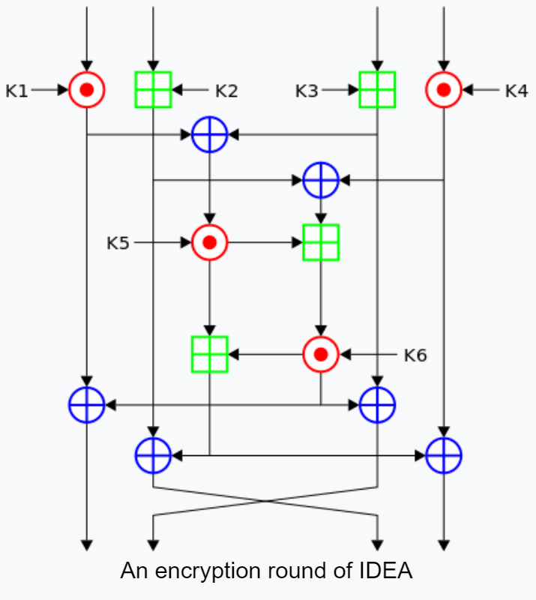
X1
X2
X3
X4
Step 1
Step 2
Step 3
Step 4
Step 5
Step 6
Step 7
Step 8
Step 10
Step 9
Step 11
Step 12
Step 13
Step 14
Y1
Y2
Y3
Y4

Slide 46
14 steps for a round
Multiply X1 with first subkey.
Add X2 and the second subkey.
Add X3 and the third subkey.
Multiply X4 with the fourth subkey.
Bitwise XOR the results of steps 1 and 3.
Bitwise XOR the results of steps 2 and 4.
Multiply the result of step 5 with fifth subkey.
Add the results of steps 6 and 7.

Slide 47
14 steps for a round(Contd)
Multiply the result of step 8 with sixth subkey.
Add the results of steps 7 and 9.
Bitwise XOR the results of steps 1 and 9.
Bitwise XOR the results of steps 3 and 9.
Bitwise XOR the results of steps 2 and 10.
Bitwise XOR the results of steps 4 and 10.

Slide 48
Swapping(Y2 and Y3) occurs for every round until the final complete round (round 8).
After eight complete rounds, the final half-round transformation occurs.
The steps involved are the following:
  Multiply Y1 with the first subkey.
  Add Y2 with the second subkey.
  Add Y3 with the third subkey.
  Multiply Y4 with the fourth subkey.
Ciphertext is the concatenation of the blocks Y1,Y2,Y3,Y4.

Slide 49
Decryption in IDEA
The decryption process uses the same steps as the encryption process. However, different 16-bit key subblocks are generated.
Each of the 52 16-bit key subblocks used for decryption is the inverse of the key subblock used during encryption with respect to applied algebraic operations.

Slide 50
Key Schedule
Each round uses 6 16-bit sub-keys, while the half-round uses 4, a total of 52 for 8.5 rounds.
The first 8 sub-keys are extracted directly from the key, with K1 from the first round being the lower 16 bits; further groups of 8 keys are created by rotating the main key left 25 bits between each group of 8. This means that it is rotated less than once per round, on average, for a total of 6 rotations.

Slide 51
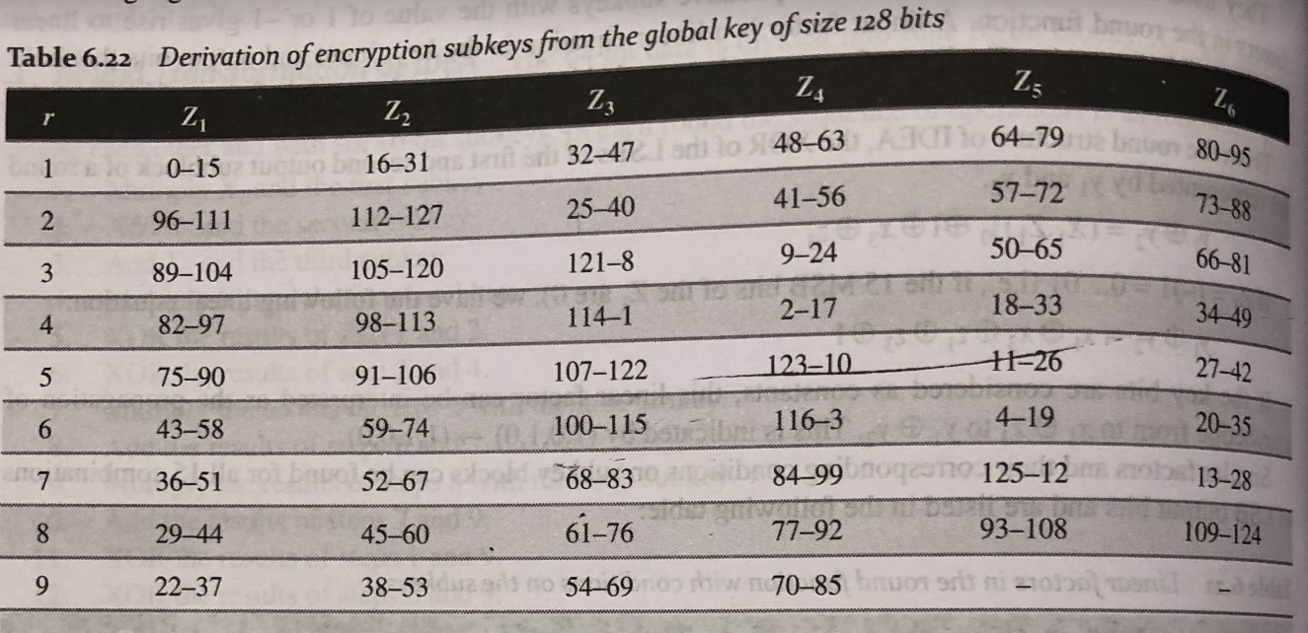

Slide 52
Summary
have considered:
  the AES selection process
  the details of Rijndael – the AES cipher
  looked at the steps in each round
  the key expansion
  implementation aspects
Notes:
Chapter 5 summary.

